Slide 1

VA’s EFFORTS IN THE NATIONAL COVID-19 CLINICAL TRIALS ON VACCINES AND THERAPEUTICS
Dial in (Main): (914) 614-3221
Dial in (Alt): (914) 339-0024
Attendee Access Code: 626-629-261
Slides in “Handout” Tab
Office of Research & Development
July 28, 2020

Slide 2
PRESENTERS (in order)
Rachel Ramoni, DMD, ScD – Chief Research and Development Officer (CRADO)
Tom O’Toole, MD – Senior Medical Advisor, Office of the Assistant Under Secretary for Health – Clinical Operations
Grant Huang, MPH, PhD – Acting Deputy CRADO – Enterprise Optimization
Victoria Davey, PhD, MPH, RN – Associate CRADO for Epidemiology and Public Health
Molly Klote, MD – Director, Office of Research Protections, Policy and Education
Terri Gleason, PhD – Director, Clinical Science R&D Service

Slide 3
OUTLINE
Update on ORD COVID-19 Response Team Activities
Overview of Operation Warp Speed (OWS) & Accelerating COVID-19 Therapeutic Interventions and Vaccines (ACTIV)
OWS Vaccine Clinical Trials
ACTIV Therapeutic Clinical Trials
Regulatory Processes and Responsibilities at Sites for OWS/ACTIV
VA ORD Funded Clinical Trials
Q&A (through Chat Line)

Slide 4
OBJECTIVES
Provide VA research community with update on OWS, ACTIV and VA national vaccine and therapeutic trials
  Operational/organizational, regulatory
To help prepare sites with local actions if selected for participation
Highlight VHA’s priority on these trials as part of its COVID-19 response
  Present ORD plans to support efforts

Slide 5
COMMENTS FROM THE CHIEF RESEARCH AND DEVELOPMENT OFFICER
AND Office of the Assistant Under Secretary for Health for Clinical Operations
5

Slide 6
VA RESEARCH RESPONSE TO COVID-19
ORD has been organizing a national VA research response to COVID-19 since March 5
  >100 work days over 22 weeks
  ORD COVID-19 SharePoint site - https://dvagov.sharepoint.com/sites/vacovhacomm/admin/projects/covid19
Federal agencies leading COVID-19 vaccine and therapeutic trials have worked with VA early in process and eager to have VA contribute

Slide 7
OPERATION WARP SPEED / ACCELERATING COVID-19 THERAPEUTIC INTERVENTIONS AND VACCINES
7

Slide 8






BRINGING TRIALS TO VETERANS
Coordination Recruitment
Clinical Insight Quality
Other Federal
Sponsors
Industry
Education
Reducing Barriers
Education
Reducing Barriers

Slide 9
ACCESS TO CLINICAL TRIALS INITIATIVE
Started in April 2018 to provide Veterans and VA investigators more opportunities to participate in industry and federally sponsored clinical trials
Goals:
  Streamline / create processes and policies to facilitate clinical trials partnerships with non-VA partners
  Increase number of high quality, multi-site clinical trials done in VA
  Establish VA as a partner of choice
Before COVID-19, VA was already working toward faster start-up of trials.

Slide 10
ORD PARTNERED RESEARCH PROGRAM
Established from the Access to Clinical Trials for Veterans Initiative
Key features:
  Single point of contact for external (non-VA) partners
  Facilitate agreements (i.e., confidential disclosure agreements, CRADAs) with help of Office of General Counsel/STAR attorneys
  Facilitate regulatory activities (e.g., Central IRB) with Office of Research Protections, Policy & Education
  Facilitate info security review with ISSO/Research Support Division
  Coordinate with VA affiliated non-profit corporations
PRP centrally coordinates clinical trials start-up process

Slide 11
OPERATION WARP SPEED
Announced May 15 to fund, coordinate, and offer regulatory support to enable the rapid development and distribution of novel diagnostics, therapeutics, and vaccines for COVID-19
Federal-wide, led by HHS Secretary Alex Azar and Defense Secretary Mark Esper, with Dr. Moncef Slaoui as chief advisor and General Gustave F. Perna as chief operating officer
OWS is swiftly implementing a series of vaccine trials and therapeutic trials including the VA research network that will involve thousands of participants
Therapeutics trials will launch through an OWS-NIH effort called Accelerating COVID-19 Therapeutic Interventions and Vaccines (ACTIV)
  antivirals, monoclonal antibodies, immunomodulators, anticoagulants

Slide 12
OPERATION WARP SPEED (OWS) PARTNERS
Department of Health & Human Services
  Centers for Disease Control and Prevention (CDC)
  Food and Drug Administration (FDA)
  National Institutes of Health (NIH)
  Biomedical Advanced Research and Development Authority (BARDA)
Department of Defense (DoD)
Department of Agriculture
Department of Energy
Department of Veterans Affairs
Pharmaceutical industry and private sector organizations

Slide 13

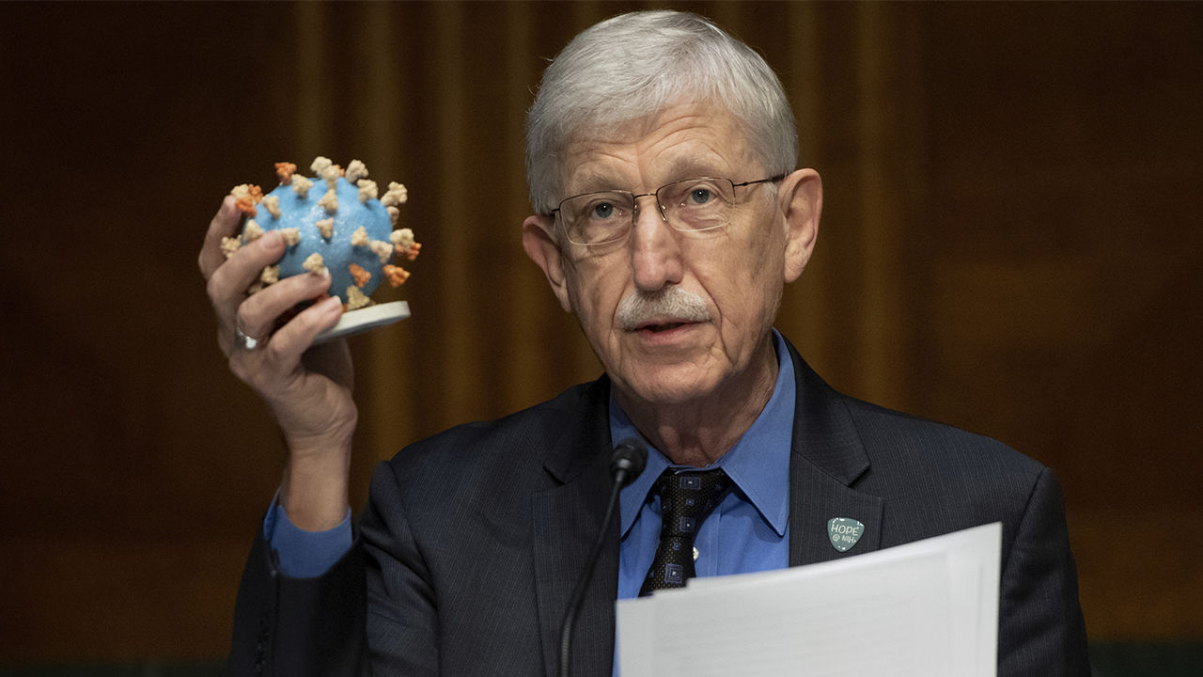
Accelerating COVID-19 Therapeutic Interventions and Vaccines (ACTIV)
Announced April 17 to coordinate and streamline processes to make the best use of biomedical research resources
Unprecedented collaboration among NIH, other Federal agencies, academia, and industry, led by Francis Collins (NIH Director) and Paul Stoffels (Johnson & Johnson).
Viewed as essential to our country’s national security, due to the health and economic impacts of COVID-19.
  See: https://jamanetwork.com/journals/jama/fullarticle/2766371

Slide 14
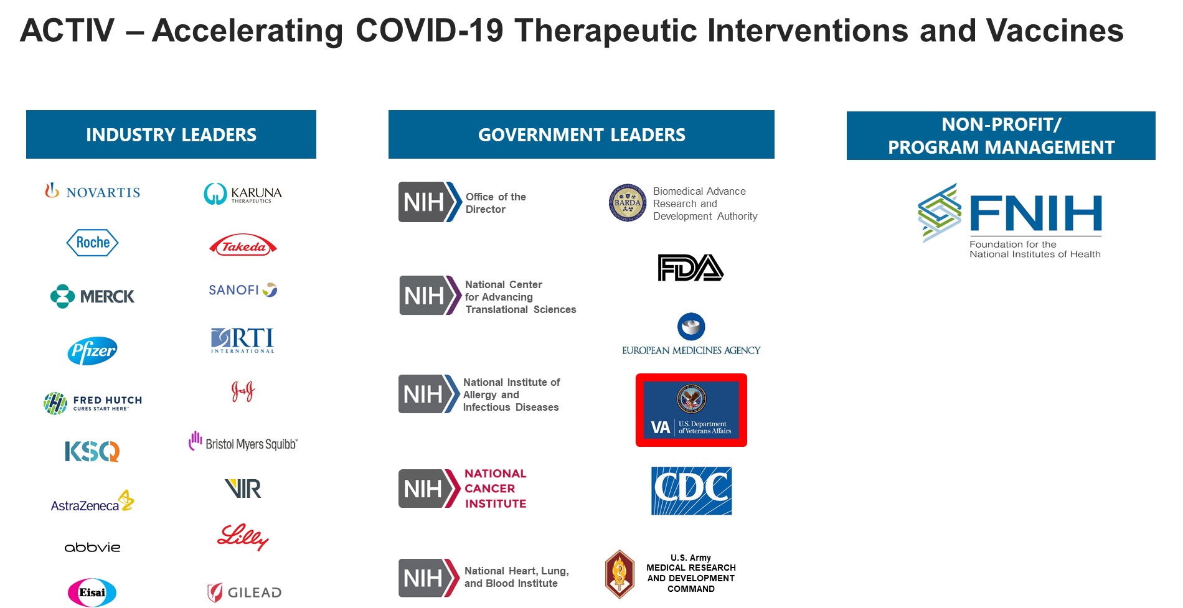
ACTIV PARTNERS

Slide 15
WHY VA IS PART OF OWS / ACTIV RESEARCH
Access to promising prevention and treatment of COVID-19 clinical trials
  Veterans gain access
  Provides opportunities for VA researchers
Scientific / clinical interests
  Provides access to biospecimens and high-quality data for additional research
  Efficiency: Multiple agents will be tested in OWS and ACTIV trials
VA has the ability to contribute to the global effort
VA has a duty to continue its leadership in clinical research that provides needed answers for the nation.

Slide 16
COVID-19 VACCINE TRIALS
Moderna / mRNA – 1273 - begins late July 2020
  Clinicaltrials.gov NCT04470427
Astra-Zeneca / AZD1222 – projected start: Aug 2020
Janssen / JNJ-78436735 – projected start: Sept 2020
VA is expecting at least 2 more vaccine trials later in 2020

Slide 17
OWS COVID-19 VACCINE TRIAL PARTNERS
National Institute for Allergy and Infectious Diseases
Coronavirus Prevention Network (CoVPN)
  Fred Hutchinson Center in Seattle, WA
    Community Engagement Work Group
Contract Research Organizations
  PPD
  IQVIA
VA – Office of General Counsel/STAR, ISSO/Research Support Division, Privacy, Clinical Operations and more

Slide 18
SITE PROCESS
ORD/PRP discusses potential sites with partners
  Heat map/predictive analytics
  VA COVID-19 sites registered through COVID-19 SharePoint
ORD/PRP contacts ACOS-R and potential site investigators
  Identify primary site point of contact
  List sent to CRO / CoVPN
CRO reviews / contacts sites
Company site selection
Site activities – IRB / Regulatory, R&D Committee, budget

Slide 19
LESSONS LEARNED
Communications - There are many partners external to VA who may contact investigators/sites directly
  Please ensure ORD is aware
  Work with your ACOS-R / R&D Office
Academic affiliates may also be participating - work with ORD to coordinate
Things may change – A rapidly developing process may result in revisions or different decisions
  Protocol, processes
Knowledge of regulatory requirements is important
  Check with ORPPE / ORD

Slide 20
PLANNED ACTIVITIES
New models for enterprise approach for clinical trials in VA
  Considers capacity, resourcing and operational needs
ORD will continue to help support sites with organizational activities
  Regular meetings with OWS/ACTIV leadership
  VA Communications plans
Discussions are on-going with Clinical Operations and coordination and support
Executive In Charge message will be delivered indicating need for local support and importance of research for COVID-19
Exploration of opportunities to enroll VA health care workers
Regulatory activities (see following slides)

Slide 21
ACCELERATING COVID-19 THERAPEUTIC INTERVENTIONS AND VACCINES (ACTIV)
21

Slide 22
ACTIV Protocols | Overview
ACTIV Therapeutics has been taking a portfolio approach to address the dramatic health and economic challenges posed by the pandemic, with harmonized efforts that address disease etiology and symptomatology.
DESCRIPTION
STATUS
ACTIV-1
Inpatient, Phase III Master Protocol
3 Host-targeted Immune Modulators
Sponsor TBD + NCATS TIN + CRO
Pre-IND submitted to the FDA
Projected to launch in early August
ACTIV-2
Outpatient, Phase II/III Master Protocol
Neutralizing Monoclonal Antibodies
NIAID ACTG + CRO
FDA letter to proceed rec’d
Projected to launch in late July
ACTIV-3
Inpatient, Phase III (2 Stage) Master Protocol
Neutralizing Monoclonal Antibodies
NIAID INSIGHT + NHLBI PETAL + NHLBI CTSN + VA + CRO
FDA letter to proceed rec’d
Projected to launch early Aug
Inpatient, Phase III Master Protocol
2 anticoagulants, leading to anticoagulant + anti-platelet, anti-thrombotics combos
Pre-hospitalized, hospitalized, and post-hospitalized cohorts
NHLBI-NINDS Network of Networks
ACTIV-4
Protocol development in progress
Projected to launch in August

Slide 23
23

Slide 24

A Multicenter, Adaptive, Randomized, Blinded Controlled Trial of the Safety and Efficacy of Investigational Therapeutics for Hospitalised patients with COVID-19
ACTIV-3/INSIGHT014
Short Title: Therapeutics for Inpatients with COVID-19 (TICO)
Funder and holder of US IND:
National Institute of Allergy and Infectious Diseases,
National Institutes of Health
and carried out by the
International Network for Strategic Initiatives in Global HIV Trials (INSIGHT)
in collaboration with other NIAID and NHLBI-supported trial networks
Led in VA by
Perry Point CSPCC
Version 1.0, 13th July 2020

Slide 25
ACTIV-3 Trial Design
ACTIV-3 is a randomized, placebo-controlled Phase III platform study. The first investigational agent will be studied in a 2-stage design. In stage 1 safety will be evaluated, and two intermediate outcomes will be assessed to determine activity. Then with seamless transition to stage 2, efficacy will be studied with a definitive endpoint. One or several agents can be studied together – sharing placebo.
Feature | Stage 1 | Stage 2
Target population | COVID-19 inpatients, symptoms ≤ 12d No organ failure | COVID-19 inpatients, symptoms ≤ 12d Organ failure allowed
Endpoint | Pulmonary/Pulmonary+ scales (ACTT-1 ordinal scale plus non-pulmonary complications) at day 5 | “Time to sustained recovery” through 90d (improved ACTT-1 time-to-recovery endpoint)
Sample size (per arm) | 150 (i.e., 300 for a single agent, 450 for two agents) | 500 (i.e. 1000/1 agent & 1500/2 agents) incl. pts from Stage 1
Power | 95% power to detect OR 1.60 for benefit; 1-sided 𝛼 of 0.30 | 90% power to detect 25% increase in recovery rate; 1-sided 𝛼 of 0.025
SOC | Supportive care; remdesivir (trial-supplied); steroids (optional and per local supply)

Slide 26

ACTIV-3 Enrollment Overview
ENROLLMENT
Goal is to have first patient enrolled on July 31, depending on availability of study product, site preparations
17 ‘vanguard’ sites go first (6 are VA: Los Angeles, Miami, Bay Pines, San Francisco, Houston, Palo Alto)
400 sites in all networks (worldwide)
Site registration/activation processes will allow ACTIV-3 to dynamically study investigational agents in fluctuating transmission ”hot spots” while carefully managing drug supply
Study completed in 1-2 years depending on COVID activity

Slide 27
ACTIV-3 Site Considerations
Advarra Commercial IRB
Requires reliance agreement
Must be included on FWA
Requires site R&DC Reviews
Privacy/Information Security
RedCap System
For data capture and randomization
Hosted outside of the VA firewall
Evaluated by VA OI&T
Site Selection
Interest
Experience
Local COVID-19 epidemiology
Ability to start rapidly

Slide 28
Steps to joining an ACTIV research study
Initial contact follows if you’ve completed the ACTIV survey in May or after we have directly gauged your interest.
  If you are uncertain about your ACTIV survey responses, let ORD know of your site’s interest at ORDCOVID19@va.gov
  There will be future ACTIV surveys to update existing VA site info and add new sites to survey data.
Receive protocol, consents, registration materials from VA Perry Point CSPCC
Complete registration, ADVARRA site approval, REDCap, etc.
Join Investigator calls (include your study team)—for
ACTIV-3, these are on Weds at 10 am EDT.
Receive site activation approval from our INSIGHT Washington DC International Coordinating Center at the Washington DC VAMC

Slide 29
LINKS
OWS https://www.hhs.gov/about/news/2020/06/16/fact-sheet-explaining-operation-warp-speed.html
ACTIV https://www.nih.gov/research-training/medical-research-initiatives/activ
CoVPN https://www.coronaviruspreventionnetwork.org/

Slide 30

REGULATORY ITEMS
For those selected to participate by the CRO or SPONSOR
30

Slide 31
Regulatory processes at sites for OWS/ACTIV
Administrative Review – Local Site
  Investigators, supporting clinics, contact information, etc…
IRB Review -Commercial IRB (no local IRB review)
  Advarra or WIRB (agreements in place – FWA updated)
    Get trained on the IRB system
      All sites may submit to WIRB through IRBNet
      CIRBI is the Advarra platform
IBC review – all current COVID vaccines are recombinant DNA products
Privacy and ISSO review – ORD will inform participating sites if reviews will be centralized with local confirmation
R&DC review – Local (prepare for ad hoc)

Slide 32

Institutional Biosafety Committee (IBC) Review
If your facility has an IBC or a memorandum of understanding (MOU)/reliance agreement with another VHA IBC or academic affiliate
  Prepare for a meeting
If your facility does not have an IBC or a MOU/reliance agreement and you could be a potential study site
  Contact IRBrelianceandSIRBexceptions@va.gov and request an IBC consultation with ORD

Slide 33

Consent and HIPAA Authorizations
VHA will use the commercial IRB consent template
  VA Sites and the commercial IRBs have been sent VA specific requirements for informed consent and HIPAA authorization.
  Local information will be added
    Investigators
    Telephone contacts
When combined: VHA will use the commercial IRB combined consent and HIPAA authorization with VA required informed consent and HIPAA authorization language
When stand alone: VHA will use the VHA 10-0493 when the HIPAA Authorization is not combined with the consent. The informed consent will contain the VA required informed consent language.

Slide 34
PREP Act
March 27, 2020 The Secretary HHS issued a federal register notice under the Public Readiness and Emergency Preparedness Act (PREP Act)
Notice provides immunity from liability (except for willful misconduct) for claims of loss caused, arising out of, relating to, or resulting from administration or use of countermeasures to COVID-19 (i.e., vaccines and therapeutics)
OGC Tort Law Group consulted on PREP Act language when a sponsor includes it in a consent form; If the sponsor includes the PREP Act language in the consent form, VHA will leave it in but modify it to language supplied by the OGC Tort Law Group.
  Language is being provided directly to the commercial IRBs
  ORD Guidance to be issued

Slide 35
Commercial IRB Process
Each investigator
  Establish an account on the WIRB and/or Advarra system
Informed Consent Form / HIPAA Authorization
  Commercial IRB Consent Form template / HIPAA Authorization Combined with Local Context included OR Commercial IRB Consent Form with Local Context included and separate HIPAA Authorization (VHA Form 10-0493)
    Template language required issued by ORD to sites
    Commercial IRBs also have the template language
VHA Endorsement Letter per facility study
  Endorsement Letter template can be found on the ORD Website: https://www.research.va.gov/programs/orppe/single_irb.cfm

Slide 36
ACTIV-3 VA PARTICIPATING SITES
VA Facilities | Advarra Reliance Status (SOPs/FWA status may vary for those as Complete) | VA Facility Commercial IRB Liaisons
Greater Los Angeles | Complete | Dr. Elizabeth Corey, (Elizabeth.Corey@va.gov) and Ms. Margaret Roch, (Margaret.Roch@va.gov)
San Francisco | Complete | Mr. Gregory Green, (Gregory.Green@va.gov) and Ms. Jennifer Ransom, (Jennifer.Ransom@va.gov)
Miami | Complete | Mr. Luis Gonzalez, (Luis.Gonzalez2@va.gov) and Dr. Minh Tran, (Minh.Tran@va.gov)
San Antonio | Complete | Mr. Cutberto Santana, (Cutberto.Santana@va.gov) and Dr. Polly Noel, (Polly.Noel@va.gov)
Bay Pines | Complete | Mr. James A. Blankenship, (James.Blankenship1@va.gov) and Ms. Whitney A. Ratliff, (whitney.ratliff@va.gov)
Phoenix | Complete | Ms. Angela Kuramoto, (Angela.Kuramoto@va.gov) and Ms. Providencia Morales (Providencia.Morales@va.gov)
36

Slide 37
Janssen Study (projected sites 7/23/2020)
VA Facility Name | WIRB Reliance Status (SOPs/FWA status may vary) | VA Commercial IRB Facility Liaisons
Atlanta VA Medical Center | Complete | Ms. Jennifer Whelan, (Jennifer.Whelan@va.gov)
Baltimore VA Medical Center | Complete | Ms. Tina McGinley, (Tina.McGinley@va.gov)
Bay Pines VA Medical Center | Complete | Mr. James A. Blankenship, (James.Blankenship1@va.gov) and Ms. Whitney A. Ratliff, (whitney.ratliff@va.gov)
Central Arkansas Veterans Healthcare System | Complete | Ms. Amy L. Lallier, (Amy.Lallier@va.gov)
Durham VA Medical Center | Complete | Ms. Stephanie Komoski, (Stephanie.Komoski@va.gov)
James A. Haley Veterans Hospital | Complete | Mr. Stanley Pettermon (Stanley.Pettermon@va.gov) and Ms. Nicole Cadorette, (Nicole.Cadorette@va.gov)
Jesse Brown VA Medical Center | Complete | Ms. AnJelique Gerstein, (AnJelique.Gerstein@va.gov)
Michael E. DeBakey Veterans Affairs Medical Center | Complete | Dr. Denise B. Naylor, (Denise.naylor@va.gov)
New Mexico Veteran Administration Health Care | Complete | Ms. Jill Baker, (Jill.Baker@va.gov)
Phoenix VA Health Care System | Complete | Ms. Angela Kuramoto, (Angela.Kuramoto@va.gov) and Ms. Providencia Morales (Providencia.Morales@va.gov)
Salisbury VA Medical Center | Complete | Mr. Nathan Bledsoe, (Nathan.Bledsoe@va.gov) and Ms. Amy Morris, (Amy.Morris3@va.gov)
San Francisco Medical Center | Complete | Mr. Gregory Green, (Gregory.Green@va.gov) and Ms. Jennifer Ransom, (Jennifer.Ransom@va.gov)
Southeast Louisiana Veterans Health Care System | Complete | Mr. Richard Mirabelli, (Richard.Mirabelli2@va.gov), Ms. Stephanie Kleehammer, (skleeham@lavrec.org) and Mr. Clay (John) Randolph, (john.randolph@va.gov)
VA North Texas Healthcare System | Complete | Ms. Beth Davis, (Beth.davis@va.gov)
37

Slide 38
Pending Commercial IRB Reliance Agreements for Janssen Study (potential)
VA Facility Name | WIRB Reliance Status (SOPs/FWA status may vary)
Birmingham VA Medical Center | Pending/Reminder for Materials 7/23/2020
Fargo VA Healthcare System | Pending/Materials sent 7/23/2020
North Florida/South Georgia VA Healthcare System | Pending/Materials sent 7/23/2020
Reno VA Medical Center | Pending/Materials sent 7/23/2020
Rocky Mountain Regional VAMC/ECHCS | Pending Agreement with Commercial IRB
Hines VAMC* | Pending Agreement with Commercial IRB
VA New Jersey* | Pending/Reminder for Materials 7/23/2020
* Site has not completed the Site Information Form.
38

Slide 39

POCs
Establish Reliance Agreement –IRBrelianceandSIRBexceptions@va.gov
WIRB system issues/training- VAreliance@wirb.com
  All facilities can submit through IRBNet vice Connexus
  Training energizer available: https://dvagov.sharepoint.com/sites/VHAORPPE/VAIRRS
Advarra system issues/training - Kathleen.Rankin@Advarra.com or Betsy.Casillo@advarra.com
August 2020: ORD will be hosting training led by the commercial IRB staff on how to use the systems

Slide 40

SNEAK PEEK – COMING ATTRACTIONS
DocuSign linked to MyHealtheVet
  Support virtual documentation of consent
VEO and Digital Media Services supporting recruitment
  Creating webpages for trials (va.gov)
  Creating volunteer portal
  Creating eCRFs
  Will send broad announcements to support recruitment
    Annie
    VSOs
    Etc…
40

Slide 41
VA TRIALS ACTIVITIES: HITCH, CURES & NETWORK
41

Slide 42
ORD Sponsored Clinical Trials Activities
  In addition to the extensive national and international collaborations described in the trials space, ORD is also sponsoring several large efforts including starting two multi-site trials, one with a master protocol, and organizing clinical trial enrollment sites in a new networked approach
  Trials Overview:
  Hormonal Intervention for the Treatment in Veterans With COVID-19 Requiring Hospitalization (HITCH). NCT04397718
  CoronavirUs Research & Efficacy Studies (CURES) Umbrella and CURES-1 RCT of convalescent plasma

Slide 43
VA HITCH Trial
Lead by Matt Rettig and Nick Nichols, WLA, 182 Veteran participants will be randomized to condition of either degarelix or placebo, single dose, as inpatients with confirmed COVID-19.
Will determine whether degarelix reduces the composite endpoint of mortality, ongoing need for hospitalization, or requirement for mechanical ventilation/extracorporeal membrane oxygenation (ECMO) at Day 15 after randomization.
First participant was enrolled week of July 19!
Initial plan was 4 recruitment sites; now plans have expanded to a total of 15 sites, with great support from VA and VHA leadership, as well as additional sites.
Thanks to those who answered the call to participate!

Slide 44
VA CURES Umbrella
With an initial charge from CRADO to develop a master protocol to facilitate our VA COVID-19 clinical therapeutic trials, the scientific team of Drs. Robert Bonomo, Sheldon Brown, Jeff Curtis, and Ed Janoff, together with CSPCC Palo Alto, have developed a master protocol focused on inpatients, with the first approved study, known as CURES-1.
CURES-1 is a much needed RCT of convalescent plasma to be conducted in 702 VA inpatients, which will begin enrolling in August. The comparisons of CP to saline will be conducted via blinded delivery, with acknowledgements to the VA Pathology Service and CSPCC Pharmacy Albuquerque for managing the operational details, including supply and availability.

Slide 45
WHAT DO WE NEED TO SUCCEED?
Like no other activity we have seen, VA Research must work highly collaboratively and as a national enterprise in order for all clinical trials to succeed under these circumstances and in these times.
From bringing new ideas to be considered under CURES or other mechanisms, through start up and implementation of trial activities, to the eventual study close when we will have answers to the trial questions regarding benefits and risks of therapeutic approaches, we need to operate as a national research enterprise
We have already recognized, and the system has responded, that we critically need our VA scientists to have time to lead these research efforts, and we need MANY individual sites willing to work at a very coordinated level to leverage capacity and reduce competition

Slide 46
WAY FORWARD
VA sponsored clinical trials will be highly coordinated across programs, with a focus on fit under CURES efforts, as well as extensive outreach to identify which promising therapeutic trials we might set up.
Clinical trial sites working on our COVID-19 trials will be joined in a new/to-be-established network that will work to support this national call to action needed to identify evidenced based treatments. Network sites will be supported in start up as well as potential inactive phases in between specific trials activities.
The end product of this type of activity will be a sharpened national VA clinical trials enterprise that is set up to fully and flexibly start, implement and complete studies as effectively as possible, leveraging all the tools within VA.

Slide 47
CLOSING REMARKS

Slide 48
PROPOSED COVID-19 TRIAL SITES – OWS, ACTIV, VA HITCH & VA CURES (as of July 2020)
Puget Sound, WA
Fargo, ND
Buffalo, NY
Boston, MA
Madison, WI
Bronx, Manhattan, Brooklyn, NY
Hines, IL
San Francisco, CA
Hines, IL
E Orange, NJ
Reno, NV
Ann Arbor, MI
Philadelphia, PA
Chicago, IL
Baltimore, MD
Palo Alto, CA
Indianapolis, IN
Richmond, VA
Denver, CO
Las Vegas, NV
Oklahoma City, OK
Nashville, TN
Durham, NC
Los Angeles, CA
Loma Linda, CA
Little Rock, AR
Salisbury, NC
Long Beach, CA
Memphis, TN
Columbia, SC
Albuquerque, NM
Phoenix, AZ
Dallas, TX
Charleston, SC
Birmingham, AL
Atlanta, GA
San Antonio, TX
Jackson, MS
Gainesville, FL
Houston, TX
Orlando, FL
New Orleans, LA
Bay Pines, FL
Tampa, FL
Miami, FL

Slide 49
CONCLUSION
VA has a unique capability to contribute to the national effort on treatments and vaccines for COVID-19
ORD is working with many VA and external partners as part of national research response
ORD has established and will continue to establish new approaches as part of national clinical research enterprise strategy to meet challenges
ORD will be supporting VA investigators / sites in their efforts to conduct national clinical trials

Slide 50
QUESTIONS OR NEED HELP?
Email:
ORDCOVID19@va.gov

Slide 51

THANK YOU AND QUESTIONS

Slide 52
AVAILABILITY OF RECORDING
A recording of this session and the associated handouts will be available on ORPP&E’s Education and Training website approximately one week post-webinar
An archive of all ORPP&E webinars can be found here: https://www.research.va.gov/programs/orppe/education/webinars/archives.cfm
52

